Slide 1
Activities in Switzerland IEA HTS TCP ExCo Meeting Milano, January 30th 2017

Slide 2
Outline
Many researchers active on theoritical superconductivity physics
MaNEP Network & many others
http://www.manep.ch/
Applied research, I will mention only 3:
Swiss Plasma Center
http://spc.epfl.ch/
University of Geneva, prof. Carmine Senatore
http://dqmp.unige.ch/senatore/
EPFL Applied Superconductivity Group
http://appliedsc.epfl.ch/

Slide 3
EFPL - Swiss Plasma Center – Superconductivity Group
LTS activities
Test of conductors for ITER (International Thermonuclear Experimental Reactor) - International collaboration
R&D on LTS conductors for future reactors (DEMO) - European collaboration
HTS activities
R&D on HTS conductors for future reactors (DEMO) - European collaboration
R&D on HTS high field inserts - Swiss national projects with Bruker Biospin
R&D on HTS currents leads - Swiss national projects with Weka AG

Slide 4
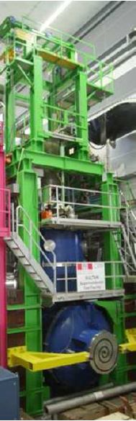

R&D on LTS conductors for Fusion
SU.L.T.AN. (SUpraLeiter Test ANlage)
Split-coil solenoid, 10.8 T
The SULTAN test facility has been used for 30 years in testing cable in conduit conductors for the fusion program.
It is the only facility for testing NbTi and Nb₃Sn conductors for ITER.
DC current for testing samples up to 100 kA

Slide 5
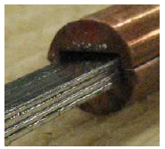
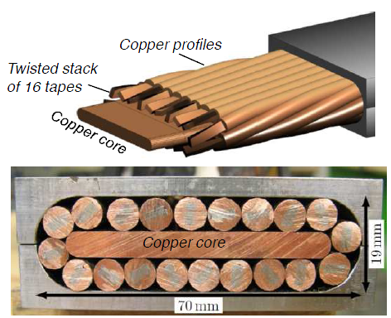
R&D HTS conductors for Fusion magnets
In house construction and test of the first large current (60 kA) HTS cable for fusion
Cable composed of twisted stack of tapes, surrounded by a soldered copper profile

Slide 6
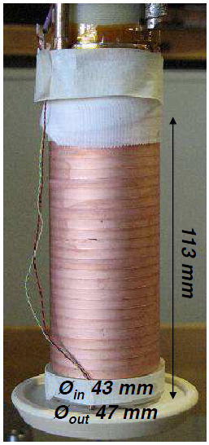
High field Magnets
HTS insert for high fields:
Research on non-insulated coils and magnets
Development of industrial processes for coil fabrication.
Contacts with most of the manufacturers of HTS tapes.

Slide 7
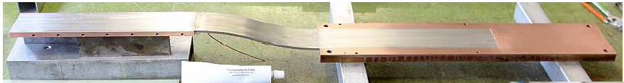
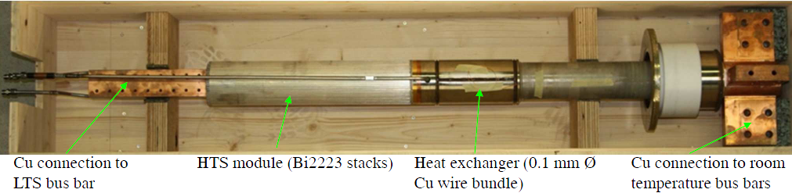
Design and manufacture of HTS current leads
“Special” REBCO current lead (100 kA at 30 K)
Bi2223 current lead (18 kA)

Slide 8
University of Geneva: Prof. Carmine Senatore
Group of Applied Superconductivity
Use-inspired basic research
Grain boundaries in HTS materials
Vortex matter
Material engineering: MgB₂
Material engineering: Nb₃Sn
Applied research on technical superconductors
Electromechanical properties
Thermal stability and thermo-physical properties

Slide 9
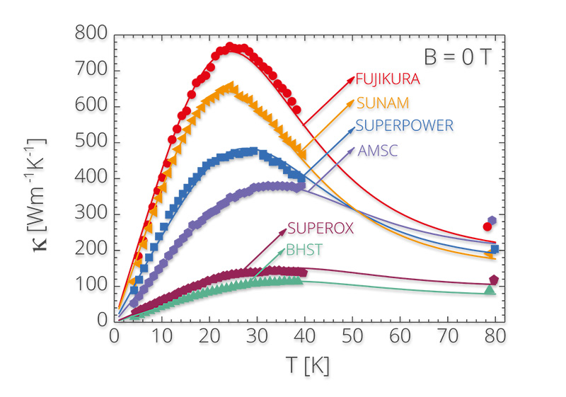
Thermal stability and thermo-physical properties
Influence of the layout of technical superconductors on the thermal transport properties:
matrix materials
stabilizer type
matrix and superconductor ratio
Is just an example of their activities, please visit:
http://dqmp.unige.ch/senatore/

Slide 10
EPF Lausanne, Group of Applied Superconductivity
Conductor characterization
Fast pulsed quench and NZPV measurements (up to 3 kA, 5 – 500 ms)
Ultrafast pulsed quench and NZPV measurements (up to 1.5 kA, 2 – 500 µs)
Conductor - nitrogen Bath heat exchange measurements
3D Quench modelling
Required to understand ultra fast quench measurements
Summer School on Modelling for Applied Superconductivity

Slide 11
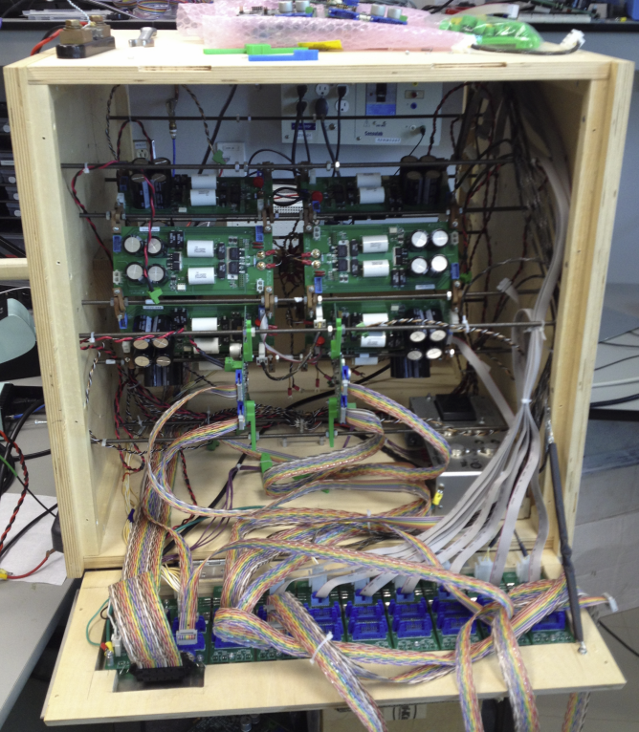
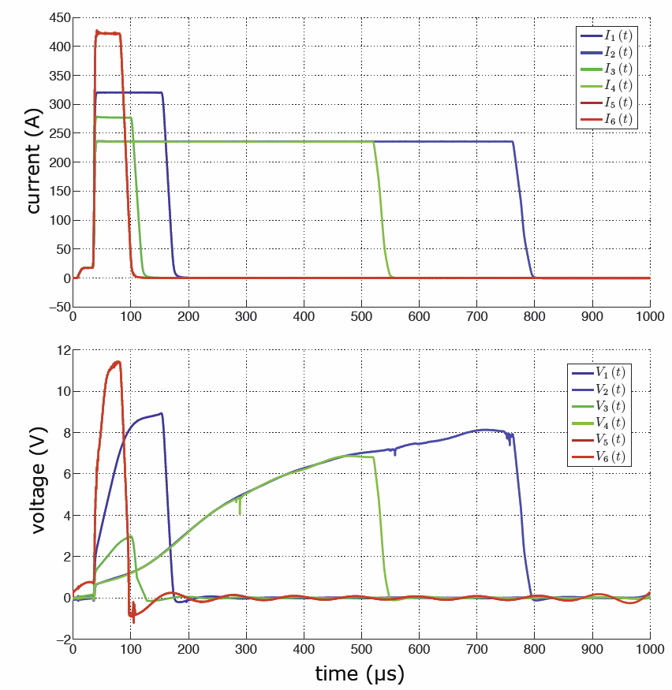
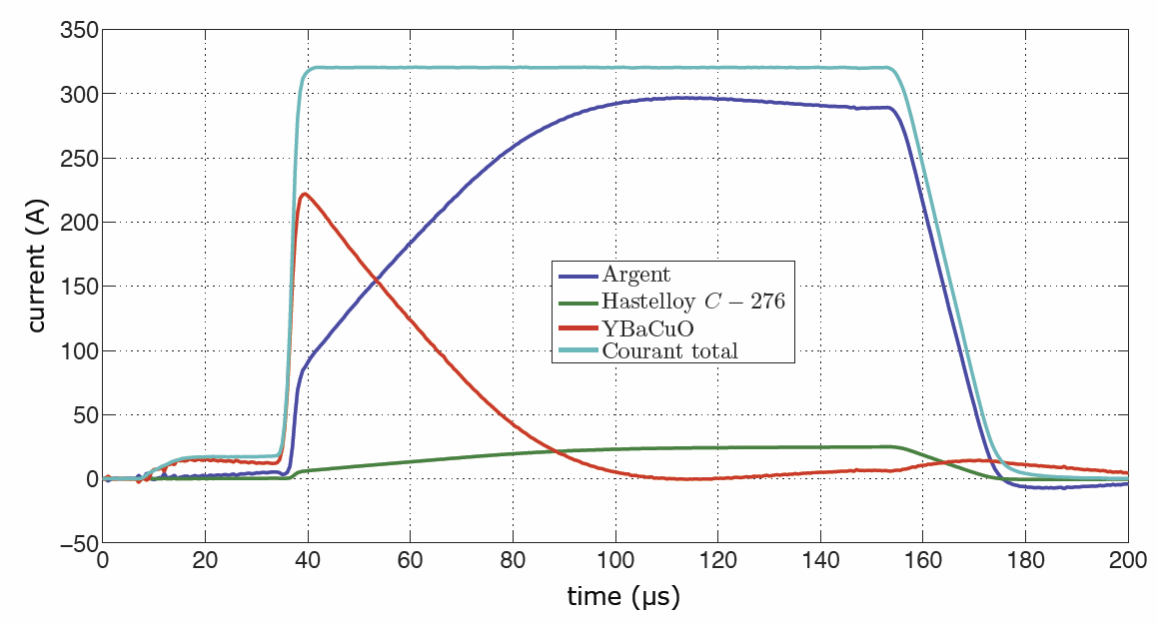
EPF Lausanne, Ultra fast Characterization
Goal: Almost isothermal V(I,B) measurements -> fast measurements
2G HTS coated conductors measured with microsecond range pulsed currents
Unique: 0 – 1000 A in < 3 µs
Up to 16 * 200A modules with local MCU
Current sharing:
Current density (and temperature) are NOT uniform in tape cross-section
Analyzing experimental results with finite elements is required in order to understand the physics and get the correct parameters
Together with Prof. Sirois, Polytechnique Montréal

Slide 12
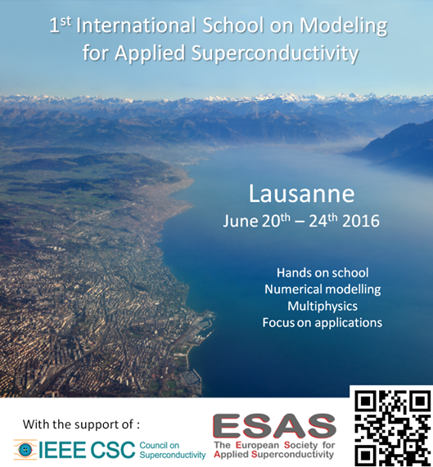

Lausanne SummerSchool June 2016
Hands on
Fantastic teachers from
CERN
Twente
KIT
Houston
Grenoble
32 students
From 15 different countries
A great success
To be renewed on a 2 years basis
Swiss Federal Office of Energy SFOE

